Slide 1
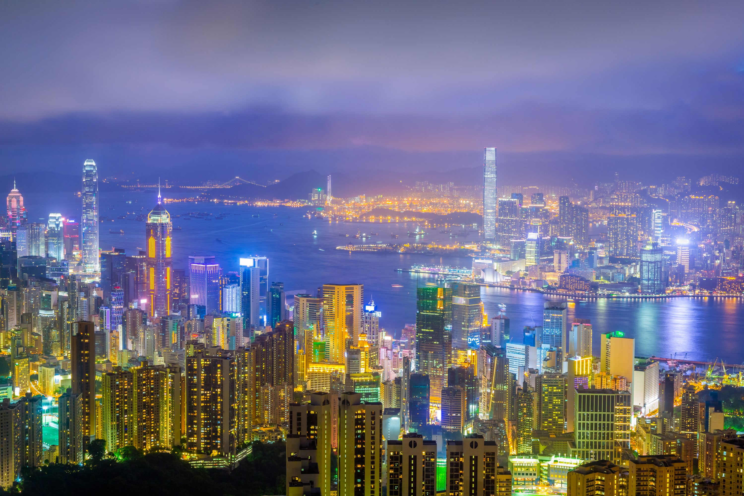
Comparative Analysis of News Media
- Hong Kong Protests -
By Benson Chen
September 19, 2019
Notes:
Thank you for coming today. I am Benson. I am doing comparative analysis of news media focusing on how they cover the hong kong protest.

Slide 2
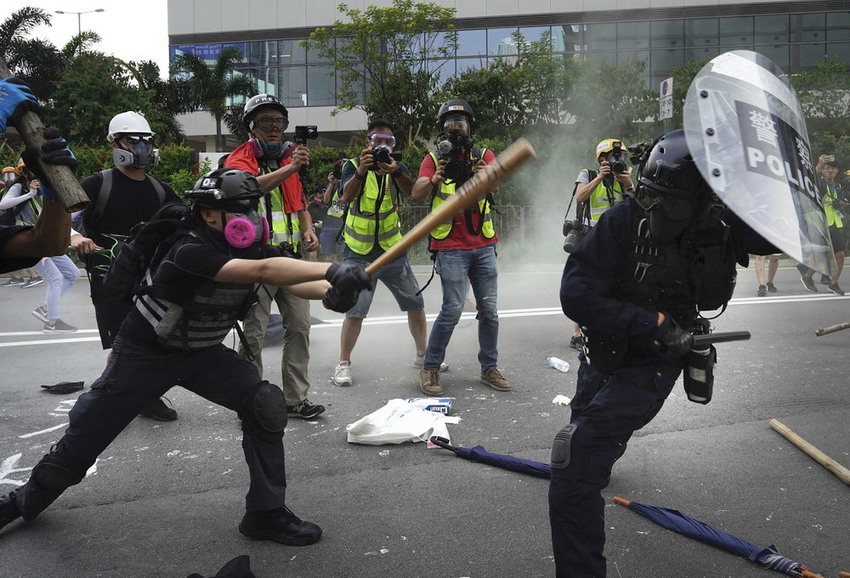
My View: Hong Kong in the Last Two Months
Journalists
Protesters
HK Police
Notes:
For me, this pic summarizes what happened in the last two months in Hong Kong. You have protesters on the left clashing with the police on the right. And a bunch journalist on the background. But is this truly represent the whole story? I want to find out.

Slide 3
Questions and Project Planning
1
Data Collection
News headlines and descriptions
How biased are the news outlets?
Text Cleaning and Preprocessing
CountVectorizer, Stop Words, Token:2Grams
2
What has been happening in Hong Kong?
Sentiment Analysis and
Topic Modeling
TextBlob and Vader for Sentiment Analysis
NMF Topic Modeling
3
What topics do different media outlets focus on the most?
Notes:
I have three questions in mind and want to answer them using NLP techniques .Are news outlets bias on reporting this matter? Second: : what has been happening in Hong Kong? Finally, What topics do different media outlets focus on the most? To do answer the question, I scraped news headlines and descriptions. Then clean and preprocess the text. Hopefully I get my answers using sentiment analysis and topic modeling.

Slide 4
Dataset Collected by Scraping Google News
Total: 1594 Headlines + Descriptions (Two Months)
USA
Hong Kong
China
550
562
482
Notes:
I scraped google news for my dataset. At the end, I got 1600 headlines plus descriptions for the past two months focusing only on HK protest. For comparison purpose, the news outline are separated by regions. 550 from USA, 562 from HK, 482 from news outlets own by the Chinese government.

Slide 5
Question 1
How biased are the news outlets?
Notes:
First, I want to know how biased are the news outlets in my dataset.

Slide 6
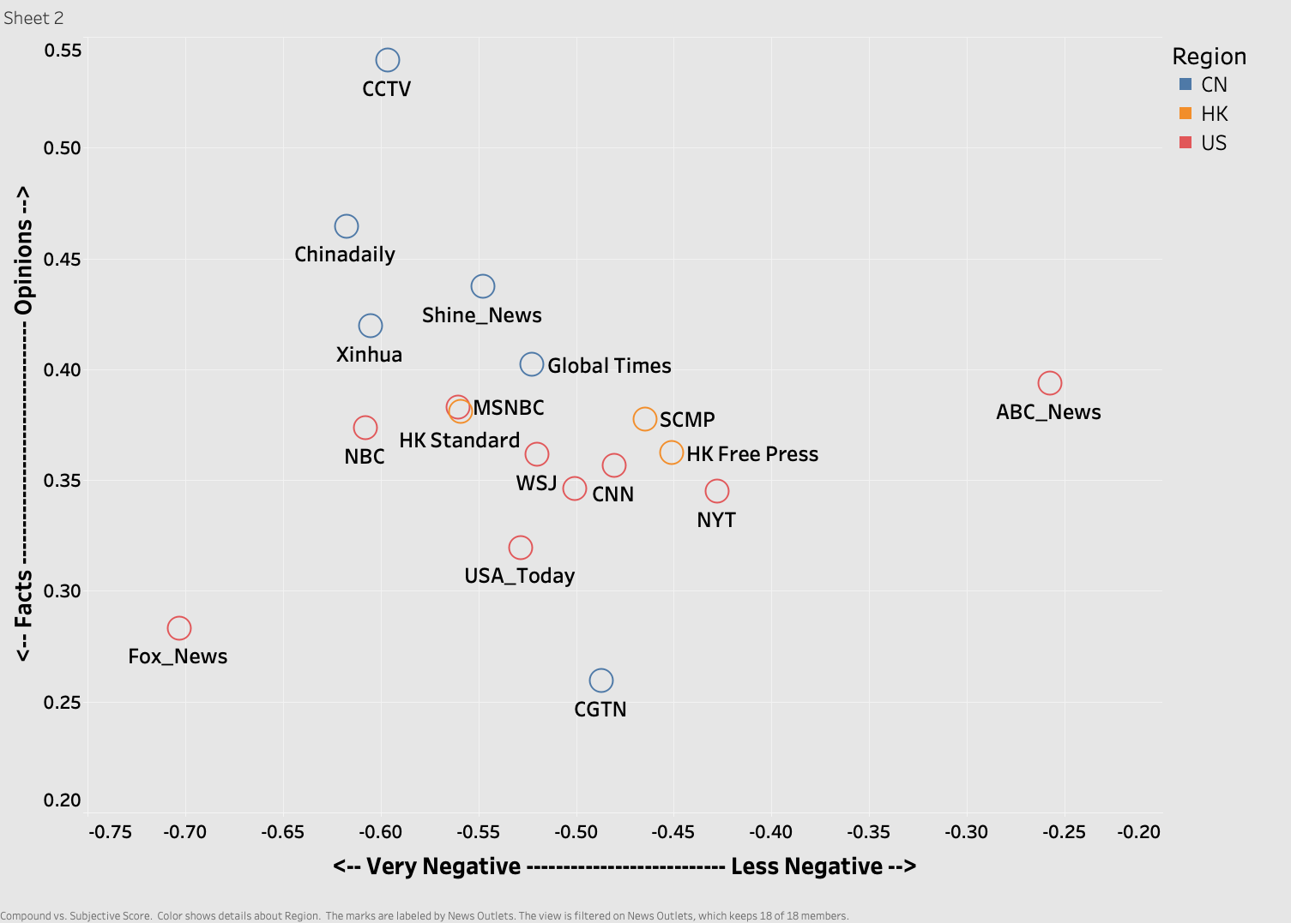
Sentiment Analysis
Notes:
To answer the question. I did a sentiment analysis using Textblob and Vader. The Chinese news outlets in blue have higher subjectivity score and higher negative score than most of the other news outlets. The US and HK news outlet are grouping in the middle.

Slide 7
Question 2
What has been happening in Hong Kong?
Notes:
Next. I want to know what has been happening in Hong Kong?

Slide 8
Topic Modeling Using NMF Method
1
2
3
4
5
Police Activities
Key Words:
Riot police
Arrest
Rubber bullet
Tear gas
Water cannon
Clash
Democracy
Key Words:
Pro democracy
Democracy movement
Activist
Criticize Protest
Key Words:
Radical protester
Violent protest
illegal
Condemn
Extradition Bill
Key Words:
Extradition Bill
Controversial
Against
Lam
Withdraw
Airport Close
Key Words:
Airport
Cancel flight
Second day
Occupy
Notes:
I perform a topic modeling using NMF Method. I have found 5 majors topics from all the headlines.

Slide 9
Question 3
What topics do different media outlets focused on the most?
Notes:
Now we know the topics, let’s found out what topics the USA, china and HK focus on.

Slide 10
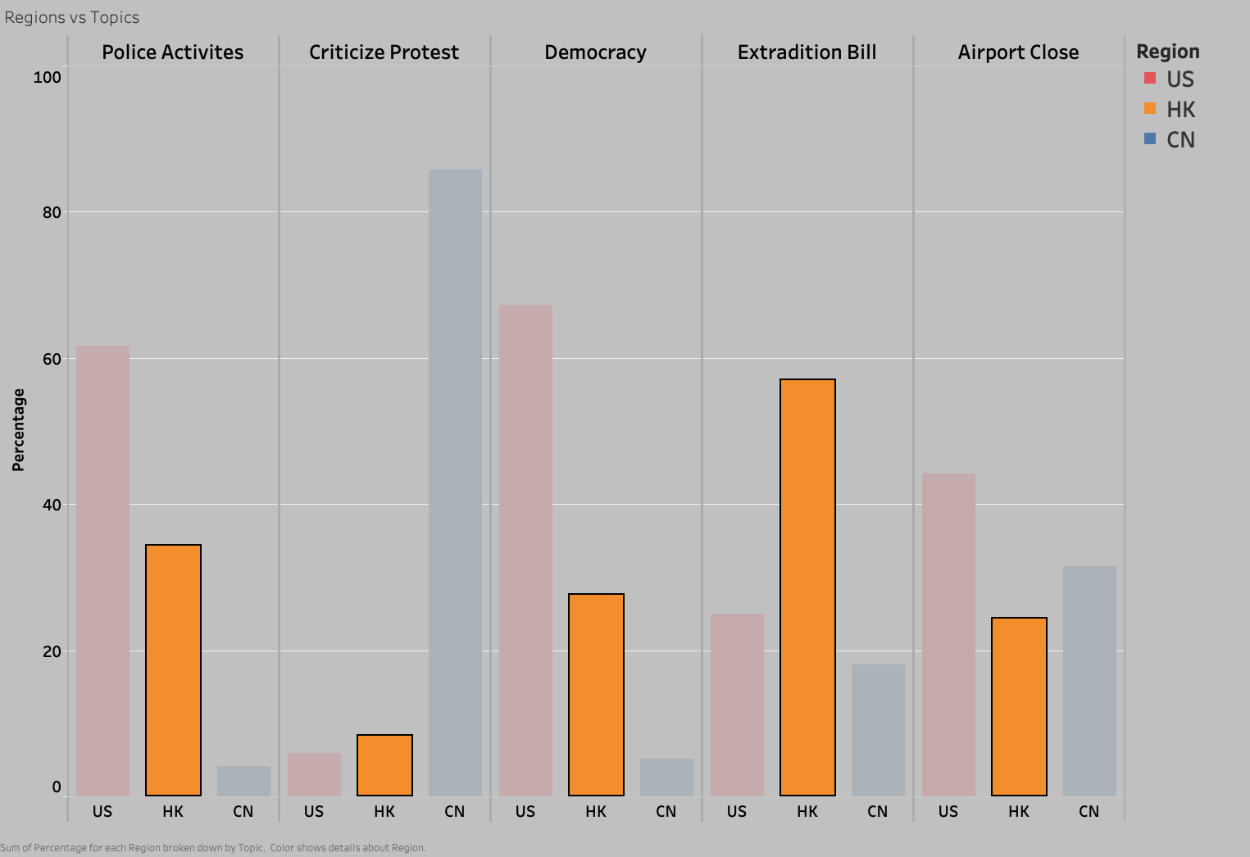
Focused Topics of HK News Outlets
US (10%)
HK (20%)
CN(70%)
US (75%)
HK (20%)
CN(5%)
US (10%)
HK (60%)
CN(30%)
Notes:
HK newspaper are more interest in the extradition bill which is dead now.

Slide 11
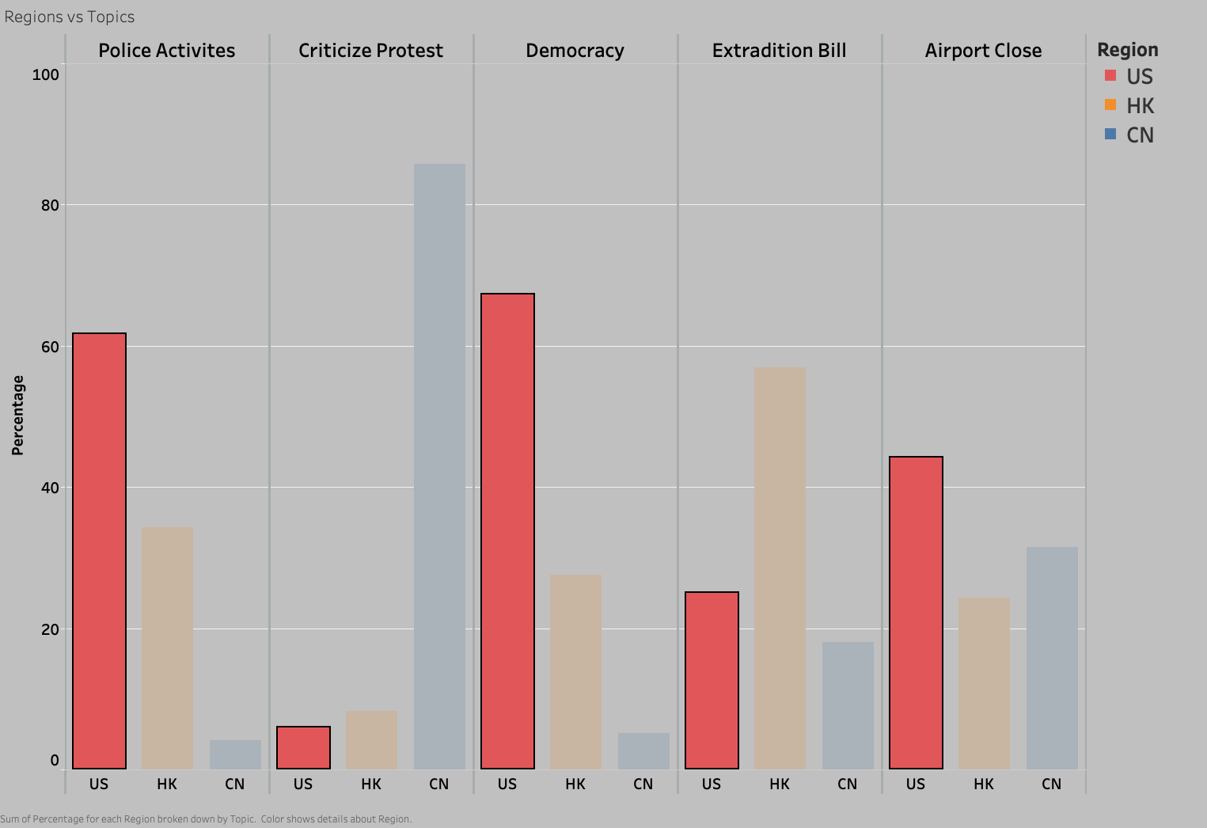
Focused Topics of US News Outlets
US (10%)
HK (20%)
CN(70%)
US (75%)
HK (20%)
CN(5%)
US (10%)
HK (60%)
CN(30%)
Notes:
USA new outlets heavily reported on police activities like attack protesters. Make sure you know the protesters are fighting for democracy.

Slide 12
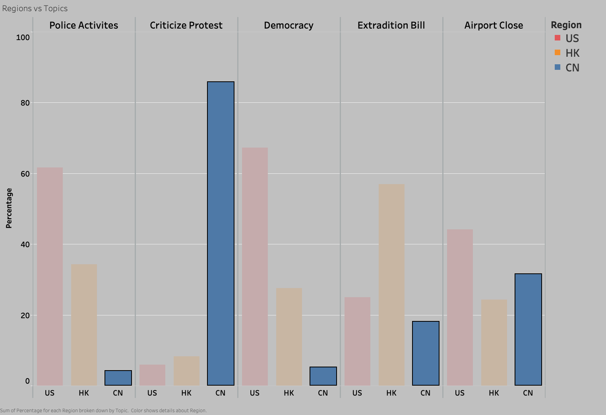
Focused Topics of Chinese News Outlets
US (10%)
HK (20%)
CN(70%)
US (75%)
HK (20%)
CN(5%)
US (10%)
HK (60%)
CN(30%)
Notes:
On the other hand, Chinese news media tried to hide what the police did, and emphasis the violent from protesters which US media doesn’t care.

Slide 13
Conclusion
NLP tools like sentiment analysis and topic modeling provided good answers to all my questions.
If you have narrow subject or question, you may able find a solution even with a small but relevant dataset.
Notes:
if you want to know more about my work please contact me.

Slide 14
Thank You!

Slide 15
Appendix
Notes:
If see if they are bias or not. I use textblob word tagging to find the average adjective for each news outline. My assuming is the more adjective you use, the more subjective you are. Looking at the bottom, many Chinese owned media tend to more adjectives along with fox news. On top, we see that BBC and NYT, Washington post wall street journal use less adjective. In my opinion they are less biased.

Slide 16
Regions vs Topics tables
Region | Topic | Percentage
US | Police Activities | 62%
HK | Police Activities | 34%
CN | Police Activities | 4%
US | Democracy | 67%
HK | Democracy | 28%
CN | Democracy | 5%
CN | Criticize Protest | 86%
HK | Criticize Protest | 8%
US | Criticize Protest | 6%
HK | Extradition Bill | 57%
US | Extradition Bill | 25%
CN | Extradition Bill | 18%
US | Airport Close | 44%
CN | Airport Close | 32%
HK | Airport Close | 24%
Notes:
If see if they are bias or not. I use textblob word tagging to find the average adjective for each news outline. My assuming is the more adjective you use, the more subjective you are. Looking at the bottom, many Chinese owned media tend to more adjectives along with fox news. On top, we see that BBC and NYT, Washington post wall street journal use less adjective. In my opinion they are less biased.

Slide 17
News Outlets and Headlines Counts
 | Count of News Outlets | Sum of Total Headlines
CN | 6 | 482
HK | 3 | 562
US | 9 | 550
Grand Total | 18 | 1594
Notes:
If see if they are bias or not. I use textblob word tagging to find the average adjective for each news outline. My assuming is the more adjective you use, the more subjective you are. Looking at the bottom, many Chinese owned media tend to more adjectives along with fox news. On top, we see that BBC and NYT, Washington post wall street journal use less adjective. In my opinion they are less biased.

Slide 18
News Outlets and Headlines Counts
News Outlets | Region | Total Headlines | % of all headlines | Subjective score | Compound | Textblob
ABC_News | US | 57 | 4% | 0.39 | -0.26 | 0.18
CCTV | CN | 15 | 1% | 0.54 | -0.60 | -0.12
CGTN | CN | 10 | 1% | 0.26 | -0.49 | 0.05
Chinadaily | CN | 39 | 2% | 0.46 | -0.62 | -0.07
CNN | US | 106 | 7% | 0.36 | -0.48 | 0.05
Fox_News | US | 28 | 2% | 0.28 | -0.70 | 0.06
Global Times | CN | 245 | 15% | 0.40 | -0.52 | -0.07
Hong Kong Free Press | HK | 212 | 13% | 0.36 | -0.45 | 0.04
Hong Kong Standard | HK | 17 | 1% | 0.38 | -0.56 | -0.04
MSNBC | US | 19 | 1% | 0.38 | -0.56 | -0.02
NBCNews | US | 30 | 2% | 0.37 | -0.61 | -0.01
Shine_News | CN | 50 | 3% | 0.44 | -0.55 | -0.06
South China Morning Post | HK | 333 | 21% | 0.38 | -0.46 | 0.03
The New York Times | US | 116 | 7% | 0.34 | -0.43 | 0.07
The Wall Street Journal | US | 80 | 5% | 0.36 | -0.52 | 0.05
The Washington Post | US | 82 | 5% | 0.35 | -0.50 | 0.01
USA_Today | US | 32 | 2% | 0.32 | -0.53 | -0.04
Xinhua | CN | 123 | 8% | 0.42 | -0.61 | -0.08
Notes:
If see if they are bias or not. I use textblob word tagging to find the average adjective for each news outline. My assuming is the more adjective you use, the more subjective you are. Looking at the bottom, many Chinese owned media tend to more adjectives along with fox news. On top, we see that BBC and NYT, Washington post wall street journal use less adjective. In my opinion they are less biased.

Slide 19
Average Adjective Counts
Notes:
If see if they are bias or not. I use textblob word tagging to find the average adjective for each news outline. My assuming is the more adjective you use, the more subjective you are. Looking at the bottom, many Chinese owned media tend to more adjectives along with fox news. On top, we see that BBC and NYT, Washington post wall street journal use less adjective. In my opinion they are less biased.

Slide 20
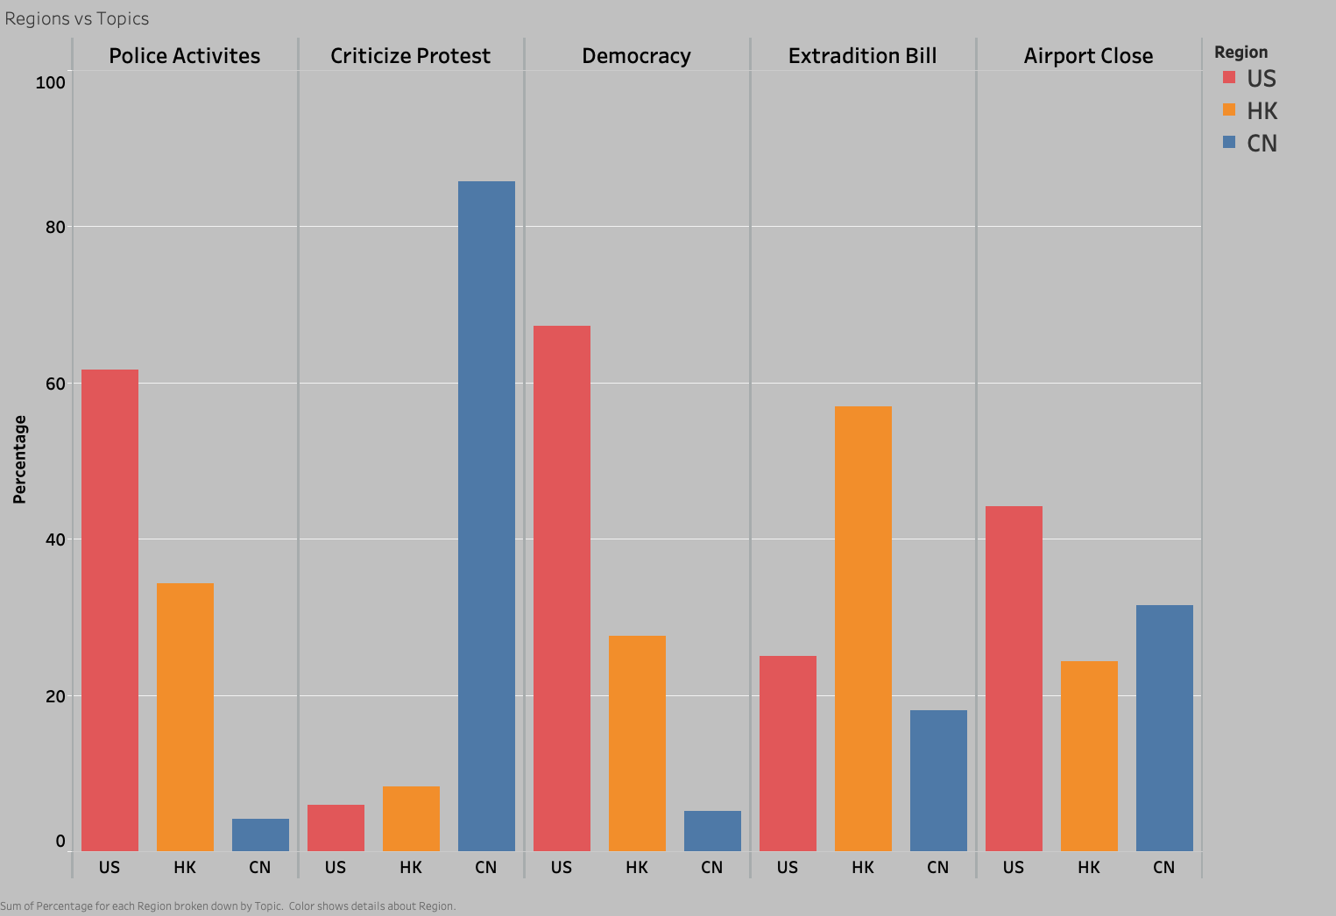
Topic Focus by regions
US (10%)
HK (20%)
CN(70%)
US (75%)
HK (20%)
CN(5%)
US (10%)
HK (60%)
CN(30%)
Notes:
Now we know the topics, let’s found out what topics the USA, china and HK focus on. USA new outlets focus more on the police activities like attack and attest protesters. On the other hand, Chinese news media reports a lot on protest violent while US media doesn’t cover much. Also the US media make sure you the protesters are fighting for democracy.
Different

